Slide 1
San Diego Regional
Dystonia Support group
March 4, 2022
Notes:
Howard is King for life of this country called dystonia; special language that only those with dystonia know
IN THE SPIRIT OF THIS HALLOWEEN WEEKEND, WE CAN CHARACTERIZE DYSTONIA AS AN UNWELCOMED UNINVITED MONSTER CREATURE THAT COMES INTO YOUR HOME (WHICH IS YOUR BRAIN) despite your hospitality the monster GIVES YOU MORE NASTY TRICKS THAN TREATS. IT THAT CAN MASCURADE IN MANY COSTUME FORMS to deceive recognition sometimes for years OUR MAIN FOCUS IN THIS MEETING TODAY IS WHAT WE CAN DO WITH SELF-CARE FOR OUR HOME IN OUR BRAINS THAT CAN HELP TAME THIS MONSTER TO IDEALLY GET IT TO LIE DOWN IN THE CORNER AND LEAVE US ALONE BUT AT LEAST BEHAVE BETTER TO GET ALONG AND INTERFER LESS WITH OUR LIFE.
Most people take for granted that the energy from our brains flows to our muscles in a balanced stream that we can regulate at will. We can think of dystonia as a river of energy flowing from the brain out of control to regions specific for each person where it be the muscls of the face, jaw, neck, larynx or extremities. THE GOAL IS HOW DO WE PUT SOME GATES ON THAT RIVER.

Slide 2
HOW TO COPE WHEN YOUR NECK FEELS LIKE STONE
This Photo by Unknown Author is licensed under CC BY-SA

Slide 3
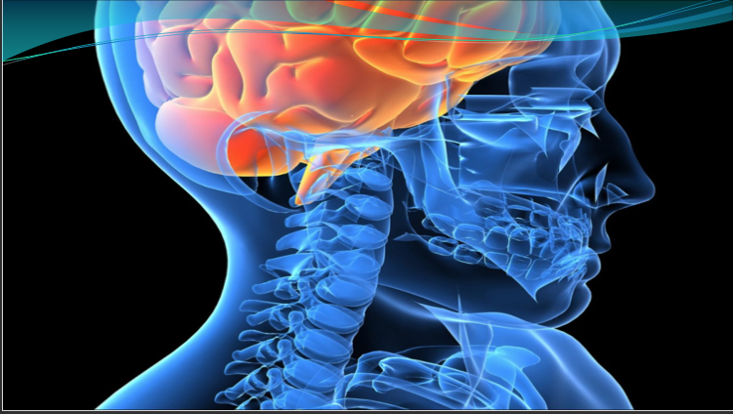
COPING WITH DYSTONIA: WHAT YOU CAN DO FOR YOURSELF
TOOLS FOR THE MINDSET OF ADAPTATION
Notes:
Howard is King for life of this country called dystonia; special language that only those with dystonia know
IN THE SPIRIT OF THIS HALLOWEEN WEEKEND, WE CAN CHARACTERIZE DYSTONIA AS AN UNWELCOMED UNINVITED MONSTER CREATURE THAT COMES INTO YOUR HOME (WHICH IS YOUR BRAIN) despite your hospitality the monster GIVES YOU MORE NASTY TRICKS THAN TREATS. IT THAT CAN MASCURADE IN MANY COSTUME FORMS to deceive recognition sometimes for years OUR MAIN FOCUS IN THIS MEETING TODAY IS WHAT WE CAN DO WITH SELF-CARE FOR OUR HOME IN OUR BRAINS THAT CAN HELP TAME THIS MONSTER TO IDEALLY GET IT TO LIE DOWN IN THE CORNER AND LEAVE US ALONE BUT AT LEAST BEHAVE BETTER TO GET ALONG AND INTERFER LESS WITH OUR LIFE.
Most people take for granted that the energy from our brains flows to our muscles in a balanced stream that we can regulate at will. We can think of dystonia as a river of energy flowing from the brain out of control to regions specific for each person where it be the muscls of the face, jaw, neck, larynx or extremities. THE GOAL IS HOW DO WE PUT SOME GATES ON THAT RIVER.

Slide 4
DYSTONIA- official definition
Dystonia is a movement disorder characterized by sustained or intermittent muscle contractions causing abnormal, often repetitive, movements, postures, or both.
Dystonic movements are typically patterned, twisting, and may be tremulous.
Dystonia is often initiated or worsened by voluntary action and associated with overflow muscle activation
Notes:
THESE ARE WORDS FOR THE MEDICAL PROFESSION SO DOCTORS RECOGNIZE DYSTONIA AS A REAL AND DON’T HAVE MISCONCEPTIONS ABOUT WHAT IT IS BUT YOU DON’T NEED A DEFINITION IF YOU ARE LIVING WITH THIS UNWANTED GUEST IN YOUR BRAIN - YOU KNOW IT BY HOW IT AFFECTS YOUR EVERY DAY LIFE. THE DEFINITION OF DYSTONIA DIFFERS FOR EVER PERSON SUFFERING WITH IT . OUR GOAL TODAY IS DEALING WITH MORE THAN THE INVOLUNTARY MOVEMENTS THEMSELVES SO I WILL JUST DISCUSS THE TREATMENT OPTIONS FIRST AS AN OVERVIEW AND TO ALLOW FOR QUESTIONS ON THIS LATER.
everyone here with dystonia knows that dystonia is what you are experiencing- the formal definition or what others are experiencing does not matter to you
A DEFINITION FOR THE MEDICAL WORLD IS IMPORTANT SINCE THERE ARE SO MANY MISCONCEPTIONS ABOUT DOCTORS WILL PICTURE DYSTONIA TO BE IN THEIR MINDS TREMOR--- OVERFLOW

Slide 5
Diagnosing Dystonia Can be a Challenge
Through increased dystonia awareness, the diagnosis is being made more rapidly than in the past but still up to 3 years post onset of symptoms
80% of patients consulted their family doctor but only 10% were diagnosed by that doctor
Many recognized by physical or occupational therapist
Most were given the misdiagnosis of psychogenic cause at some point before the dystonia was correctly diagnosed
Notes:
Through increased dystonia awareness, the diagnosis is being made more rapidly than in the past but still often over 3 years from onset.
80% consulted their family doctor but only 10% were diagnosed by the family doctor; Many finally recognized by a physical or occupational therapist
Most were given the misdiagnosis of a psychogenic cause at some point before the dystonia was correctly diagnosed.

Slide 6
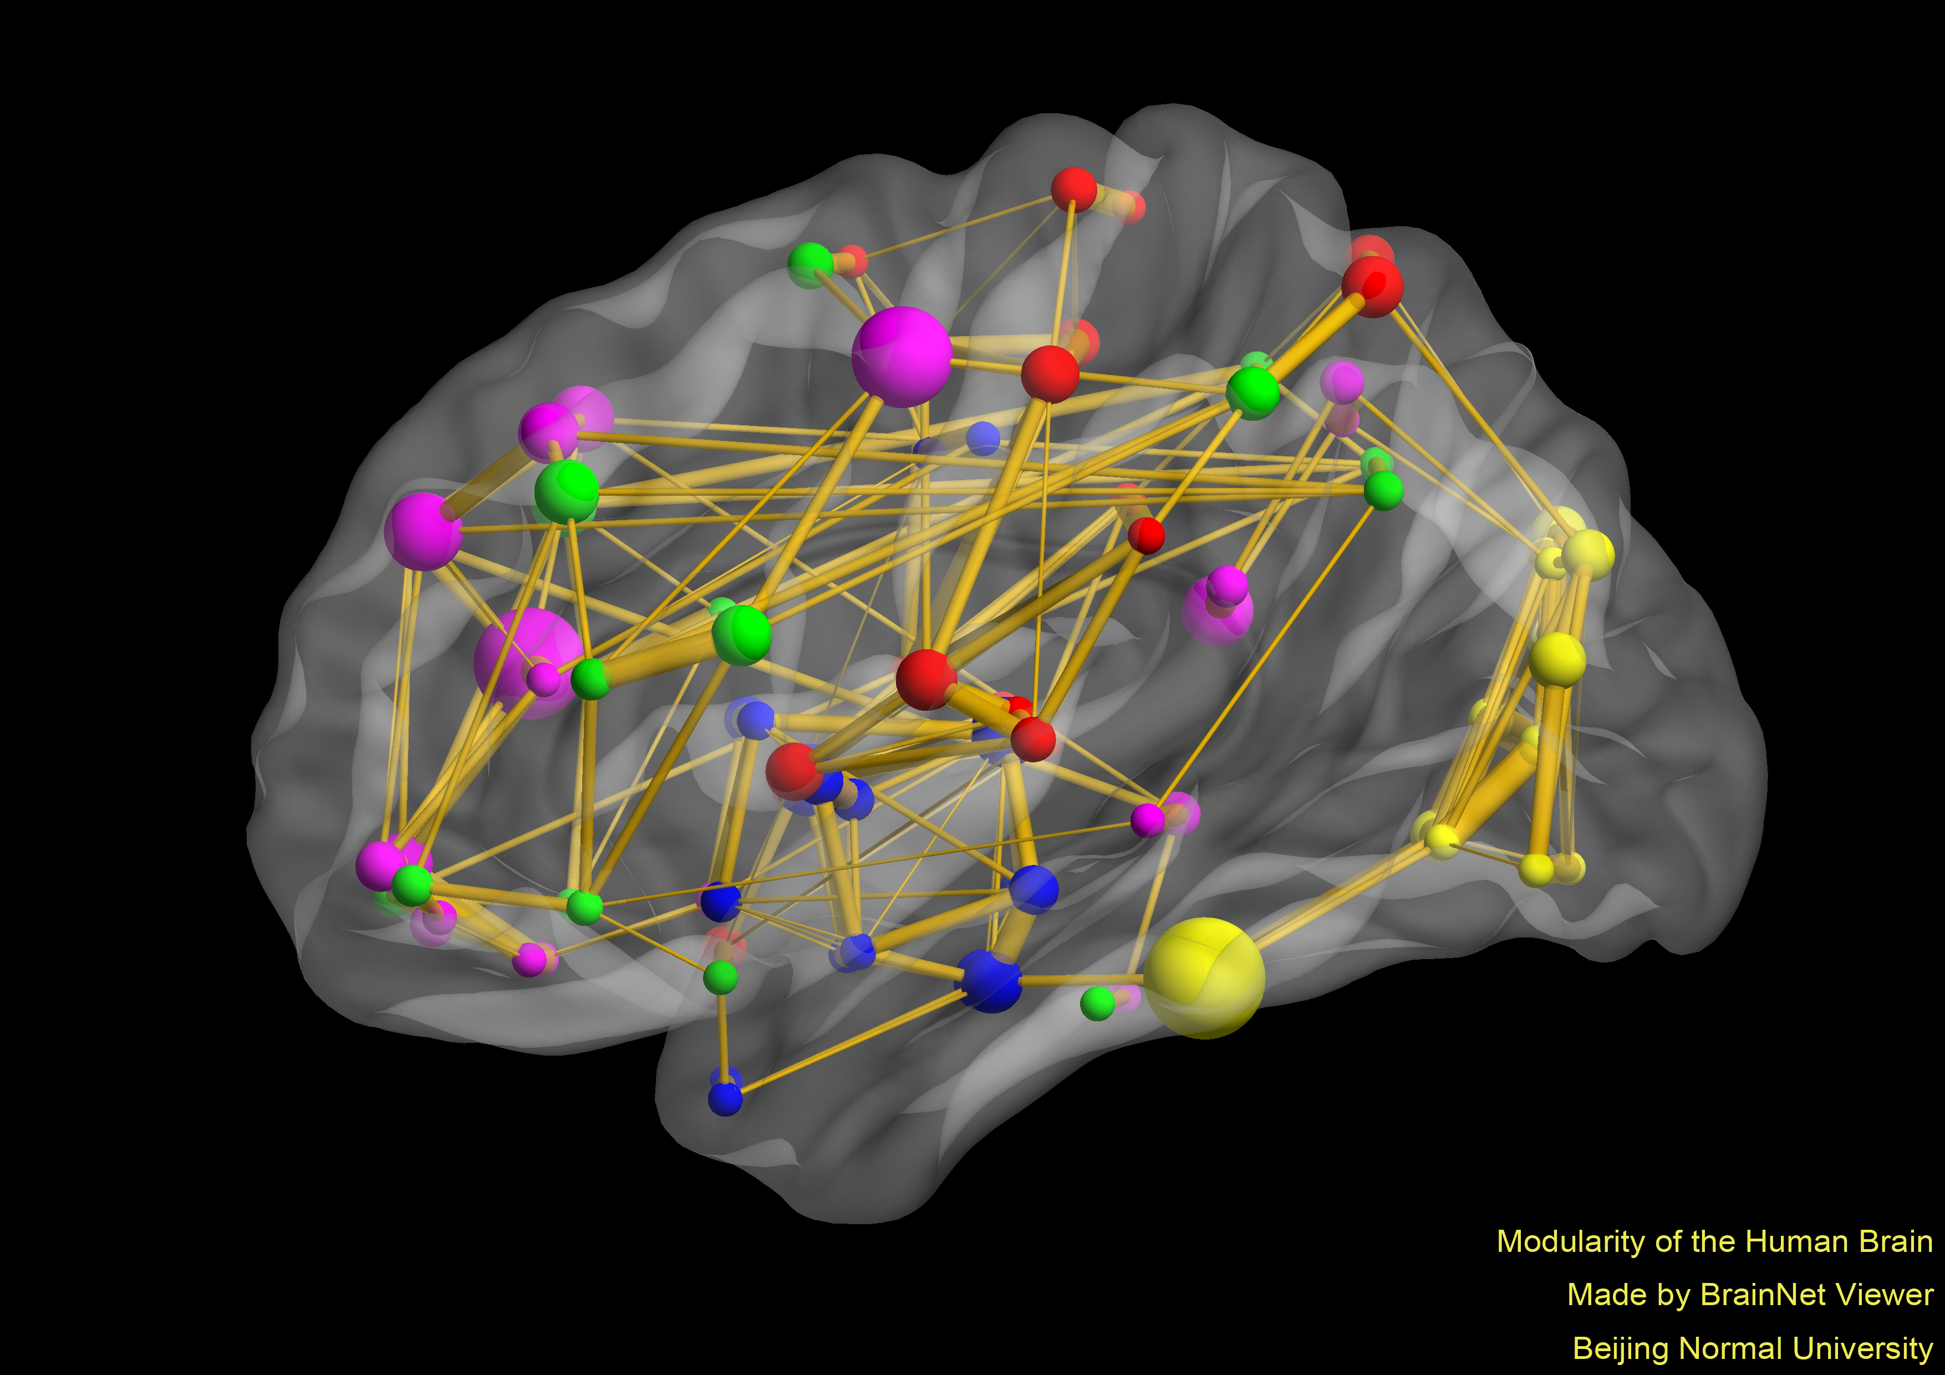
Dystonia
Origin in multiple brain regions including the basal ganglia, thalamus, midbrain, cortex and cerebellum
Considered a
network disorder
This Photo by Unknown Author is licensed under CC BY-SA

Slide 7
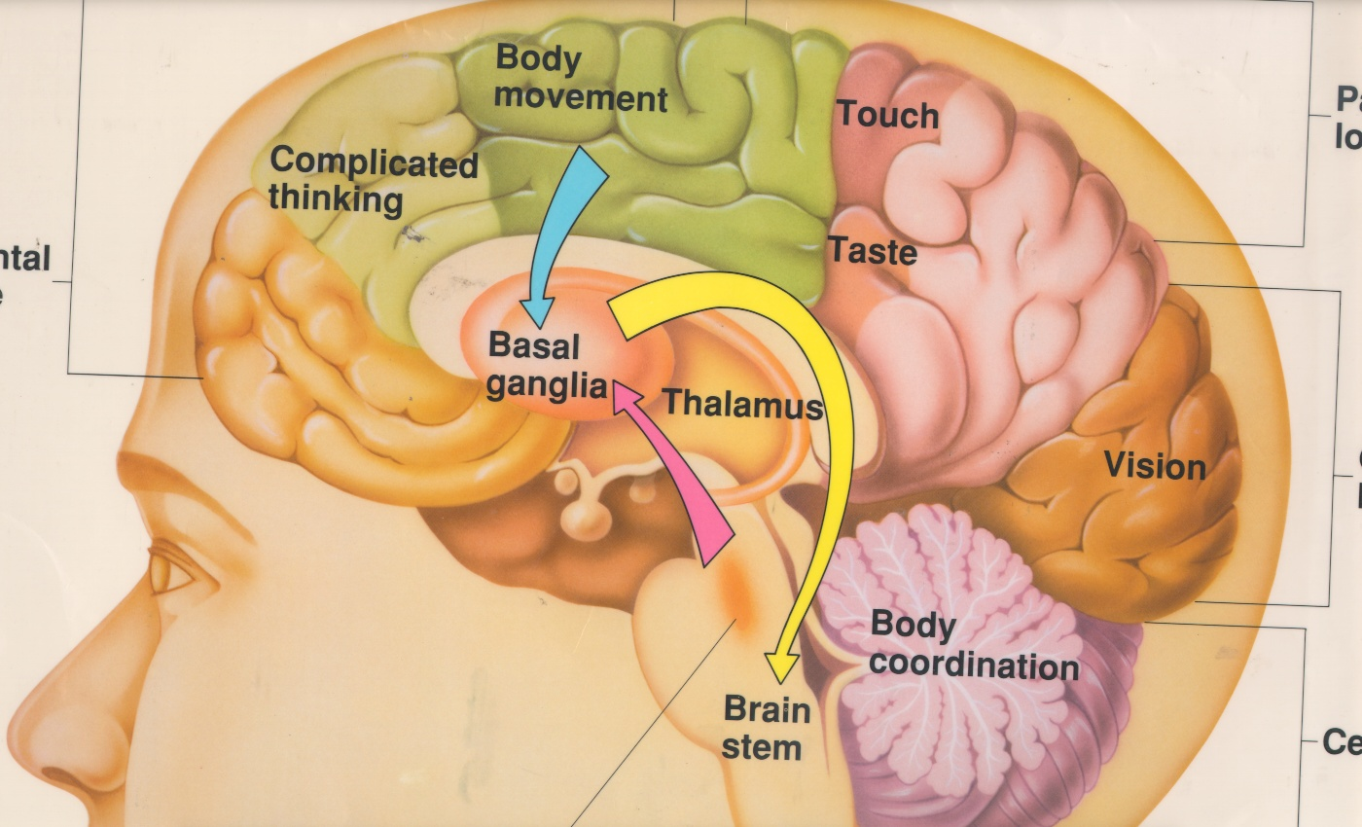
Notes:
Most people take for granted that the energy from our brains flows to our muscles in a balanced stream that we can regulate at will. We can think of dystonia as a river of energy flowing from the brain out of control to regions specific for each person where it be the muscls of the face, jaw, neck, larynx or extremities. THE GOAL IS HOW DO WE PUT SOME GATES ON THAT RIVER.
There has been much INVESTIGATION on where dystonia arises from but it is certain that it is more than one spot in the basal ganglia . IT IS a disruption IN THE integration of multiple circuits in DIFFERENT PARTS OF THE brain that are communicating with each other with neurotransmitter chemicals THAT NORMALLY REGULATE the muscle ENERGY balance WE HAVE MEDICAL AND SURGICAL TREATENTS THAT WE WONT FOCUS MUCH ON EXCEPT MAYBE IN OUR DISCUSSION SECTION THIS AFTERNOON.
IN DYSTONIA, INSTEAD OF A NICE STREAM OF ENERGY SYMMETRICALLY, THERE IS A RIVER OF ENERGY TO A GROUP OF MUSCLES
WHAT CAN WE DO TO MODIFY THIS ELECTRICAL ENERGY IF WE CAN NOT STOP IT - OCCASIONAL SURGICAL MEASURES CAN BE HELFPFUL BUT NOT AS RELIABLE AS WITH PARKINSON’S
SO WE NEED TO DO ALL WE CAN FROM AN INTERNAL BASIS ALONG WITH MEDICAL THERAPY. The point of our meeting today will not be on medical therapy but on self- help measures and conditions associated with Dystonia.
AN OUT OF CONTROL ELECTRICAL GENERATOR SENDING TOO MUCH ENERGY TO AN ELECTRIC CAR PUTTING IT OUT OF CONTROL– WE CAN CONTROL THAT BY PUSHING THE BREAK ON THE CAR, CUTTING WIRES FROM THE GENERATOR TO THE CAR OR PUTTING A DAMPER ON THE GENERATOR BUT THAT DOES NOT ADDRESS WHAT CAUSED THE GENERATOR TO BE OVERACTIVE IN THE FIRST PLACE--- IT HAS BEEN THE THOUGHT THAT IT IS A GENETICALLY DETERMINED CHEMICAL PROBLEM IN THE BASAL GANGLIA WHICH IS LIKELY WITH GENERALIZED DYSTONIA BUT AS DR FARIAS HAS DISCUSSED, MORE LIKELY ARISES FROM THE PRE-FRONTAL CORTEX BY A BRAIN SHOCK DISRUTING THE BALANCE OF EXCITATORY AND INHIBITORY CIRCUITS
We know now that dystonia is not just the result of the basal ganglia being our of adjustment, but instead a disturbance from the neurocircuitry above in the cortex--- cortical shock according to dr Farias- may be genetically determined in certain people

Slide 8
Focal Dystonia Types
Blepharospasm– involuntary eye movements
Oral Mandibular– facial and jaw movements
Laryngeal– tight or tremulous voice
Cervical– head and neck twisting or tremor
Limb Dystonia– writer’s cramp dystonia, occupational dystonia, musician’s dystonia
Notes:
All have been misdiagnosed due to lack of recognition of dystonia
We can recognize someone instantly but can’t do so if you never were introduced.

Slide 9
Core Pathology of focal Dystonia
Brain maladaptive plasticity is producing the excessive energy output to specific muscles
The problem lies in the the brain not applying the brakes to functions that must be regulated to allow normal movements to occur
Notes:
WE WILL BE HEARING THIS WORDS OF PLASTICIITY OFTEN- MEANING THAT THE BRAIN IS MOLDABLE AND IF IT DOESN’T MOLD CORRECTLY TO A STIMULUS, DYSTONIA CAN RESULT.
WE HAVE A SYSTEM OF EVERYTHING BEING IN BALANCE LIKE A BALANCED SCALE OR TEETER TOTER TO ALLOW JUST THE RIGHT AMOUNT OF ENERGY TO GO THE MUSCLES. LIKE CONTROLLING A CAR TO JUST THE RIGHT AMOUNT OF ENERGY TO TIRES TO CONTROL THE SPEED BUT IF THE BRAKES MALFUNCTION THEN YOUR CAR IS SPEEDING OUT OF CONTROL

Slide 10
Faulty Brakes in Dystonia
The “brakes” are the inhibitory circuits and inhibitory neurotransmitters
Especially in the prefrontal cortex of your brain to regulate the proper outflow of energy to the muscles
Notes:
THESE BRAKES ARE CIRCUITS IN THE BRAIN THAT INHIBIT THE EXCESSIVE ACTIVITY- THESE CIRCUITS ARE CONTROLLED BY CHEMICALS THAT ARE EXCITATORY OR INHIBIT ( HOLD BACK THE ENERGY) – SOMETHING IS WRONG WITH THAT ( AND THE BIG QUESTION IS WHAT IS THAT SOMETHING THAT IS WRONG)
Need to go to the Les Schwab for brain brakes
Dr Farias focuses his work of reprogramming dystonia on the prefrontal cortex
sorry to tell you this- but f you have dystonia it is all in your HEAD as on the next slide of the DMRF t shirt

Slide 12
Treatment of Dystonia
Botulinum medication (toxin) injections
Oral Medications
Surgical treatment options
Neuroplasticity – MINDSET

Slide 13
Botulinum medication in clinical practice and the ART of precise administration
Botox (onobotulinum) Xeomin (incobotulinum)
Dysport(abobotulinum)
Myobloc (rimabotulinum)
? Potentially Doxxify
Notes:
Myobloc has especially good antinociceptive properties

Slide 14
Neuroplasticity ..the brain’s ability to change and adapt as a result of experience
Kendra Cherry Dystonia, April 2016

Slide 15
Brain Neuroplasticity
The inherent capacity of brain cells to modify themselves and their functions allowing us to learn, adapt, change and recover

Slide 16
Dystonia is a movement disorder that causes aberrant plasticity
You get very good at doing the movements associated with your dystonia
Mikki Townshend

Slide 17
Mindset Attitude and Positive Thought Really Do Make a Difference
Thought energy can affect how the genes are expressed
Attitude and positive thought can produce epigenetic changes in how the brain functions
Notes:
We have the ability to edit the data we enter into our biocomputers just as we type words into our computers or powerpoint
We become masters of our fate and not victims of our genes
He discussed the development of our cells – from 2 billion years ago when single celled organisms started to coalesce into multicell organisms and needed receptors and eventually emotions and thought to interrelate to the environment

Slide 18
Holistic Treatment for Dystonia: Promotes Neuroplasticity
MENS SANA CORPORE SANO
The healthier your BODY can be and
the healthier your MIND can be,
the better your BRAIN will work and
the better your DYSTONIA will be controlled.
Notes:
We may not be able to control the muscle overactivation from the brain but we can control how healthy the brain is and that will impact the extent of the dystonia

Slide 19
MINDSET treatment for dystonia treatment
THE MIND-BODY CONNECTION IS POWERFUL
THE PROPER MINDSET CAN PRODUCE PHYSIOLOGIC CHANGES IN THE BRAIN AND BODY and IMPROVE CONTROL OF DYSTONIA
BAD STRESS UNIVERSALLY WILL AMPLIFY DYSTONIA so a Mindset of managing stress is therapeutic

Slide 20
Mindsets can help recovery
Mindset of expectations of healing can trigger measurable changes in the neurologic, cardiovascular, endocrine and immune systems.
Positive mindset triggers areas in the brain associated with anxiety and pain and activates healing outcomes
THE POWER OF PLACEBO IS A POSTIVE MINDSET
The power of placebo is driving the mindset that the treatment will be effective

Slide 21
Check list for healthy living for EVERYONE
1. EXERCISE- Number one on the list for most disorders
2. Yoga / Restorative exercises / Meditation
3. Restorative SLEEP
4 Healthy NUTRITION- focus on mostly plant-based eating
5 Social and support network connection
6. Travel- or plan to travel – have it on your calendar
7. Positive attitude/ MINDSET

Slide 22
Mindsets for physical activity
Instead of being discouraged by physical activity or tasks, pace yourself to improve with baby steps, take breaks and use adaptive methods to get it done
Set goals for the future, but especially set goals for every day-- no matter how small!
The Brain adapts to a CHALLENGE - Neuroplasticity

Slide 23
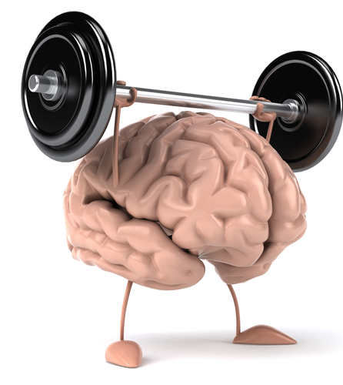
What are our tools?
Exercise: aerobic, strengthening, balance and agility
Neuromuscular reeducation
Mindfulness and Meditation
Breathing ( BREATH- James Nestor)

Slide 24
“ if it fires together, it wires together”
Managing Dystonia also requires a “rinse and repeat” strategy to set up competing neuronal connections and strengthen them

Slide 25
EPIDEMIOLOGY
DEPRESSION and Anxiety in DYSTONIA are very COMMON
Depression often starts before dystonia
Similar networks in the brain are involved
Depression can worsen dystonia and treatment of depression can improve dystonia
?

Slide 26
Prevalence of Anxiety Disorder in People
With Adult Onset Isolated Dystonia
25-40% of people studied with dystonia had clinically relevant anxiety or anxiety disorder
Social Anxiety is most common form of anxiety found in the studies with dystonia

Slide 27
Definition of Anxiety
“Anxiety is a state of apprehension and physical arousal in which you believe you can’t control or predict aversive future events.”
It is driven by “what if” thinking.
It can be a negative Mindset

Slide 28
EPIDEMIOLOGY
IMPACT on QOL *
Depression and anxiety are major contributors to reduced quality of life in dystonia patients, even larger than the severity of the dystonia itself –
Can be a negative Mindset
In one study of 542 patients with mostly focal dystonia surveyed, 43% had anxiety, 40% had depression.

Slide 29
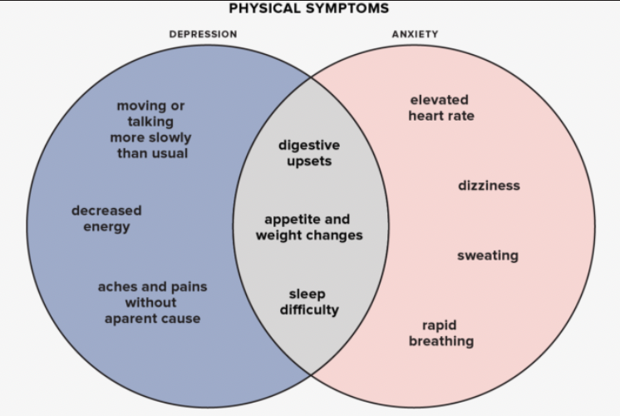
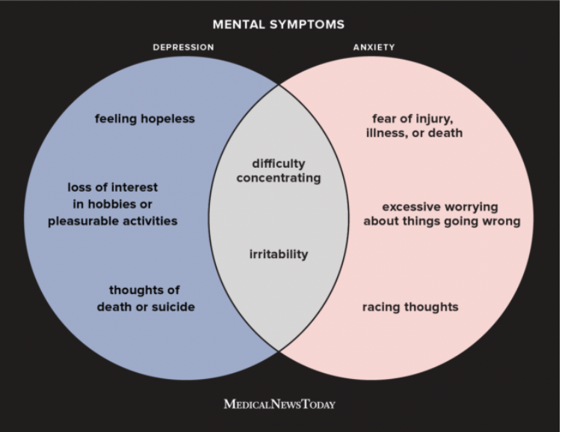
DEFINITIONS: DEPRESSION
Both PHYSICAL and MENTAL SYMPTOMS
OVERLAP with ANXIETY

Slide 30
RATIONALE for TREATMENT of depression with dystonia
TREATING BOTHERSOME ASPECTS/ CONSEQUENCES OF DYSTONIA MAY HELP MOOD
IMPROVED MOOD CAN HELP DYSTONIA SYMPTOMS
EXERCISE + ENRICHED ENVIRONMENT and POSITIVE MINDSET==> SYNAPTOGENESIS
Avoid Medications that block dopamine

Slide 31
Mindset for Depression
Research studies from Stanford have demonstrated that “a stress-is-enhancing mindset mitigates the development of depressive and anxiety symptoms”
( Having the mindset that stress can be a positive to avoid development of depression and anxiety about a disorder)
Involvement in a dystonia group or other social group avoids isolation that can lead to depression and anxiety

Slide 32
Hormesis
Physical or psychological stress or adversity will make you stronger to deal with future stress or adversity

Slide 33
Coping with dystonia –
“I am in the mindset of being in the driver’s seat and not a passenger in my own life
I am in the mindset that you manifest your life through your thoughts and actions
I have been dealt this hand and am going to play it to my advantage.”
James Sutliff

Slide 34
Tom Seaman – Mindset for coping with dystonia
“We all need to grieve, but we can’t let it last forever. To be happy, we can’t continue to dwell on what once was. All we have is the present moment so that is where our attention needs to be.
When we focus on the abilities we have now, acceptance follows, giving us greater peace of mind and a happier life.”

Slide 35
Work with what you have and always hope for something better

Slide 36
MINDSET OF Dancing with the Dragon
An exploration of changing our relationship to ourselves
Patrick Hogan –restorative movement coach in New York

Slide 37
“Between stimulus and response there is a space. In that space is our power to choose our response. In our response lies our freedom.” – Viktor Frankl

Slide 38
Maya Angelou
“ If you don’t like something change it and if you can’t change it, change your attitude”

Slide 39
“I live in continuous creative response to the present moment”
Yogi Amrit Desai

Slide 40
“Comparison is the thief of joy”
Winston Churchill

Slide 41
“Make it part of your lifestyle and
it takes motivation off the table”
Dali Lama

Slide 42
Human connectivity BDNF hormesis– increased reliance to subsequent or current stressors at times “don’t do something just sit there” Comparison is the thief of joy- Churchill Fun is the vitamin for the mind work with what you have but always hope for something better Brain responds to our life experiences and thought to produce neuroplastic changes negative thoughts are like weeks in the brain Epigenetics- what we do can effect the function of the DNA diseases of behavior- dying by our quest to always be comfortable exercise actives PGC-! Alpha that stimulates IRISIN that leads to increased BDNF in the brain Epigenetics determines Phenotype expression Lifestye voids the warranty on our bodies make it part of your lifestyle and it takes motivation off the table- Dali Lama

Slide 43
Check list for healthy living for EVERYONE
1. EXERCISE- Number one on the list for most disorders
2. Yoga / Restorative exercises / Meditation
3. Restorative SLEEP
4 Healthy NUTRITION- focus on mostly plant-based eating
5 Social and support network connection
6. Travel- or plan to travel – have it on your calendar
7. Positive attitude/ MINDSET

Slide 44
Dancing With The Dragon

Slide 45
WHAT ARE ADAPTOGENS? Joan Hogan RD
PLANT, HERB, BEAN OR FUNGI
HAVE BEEN STUDIES FOR OVER 1000 YEARS
HELPS IN ADAPTATION TO STRESS
REESTABLISHES BALANCE
SAFE AT ANY DOSE

Slide 46
STRESS AND ADAPTOGENS

Slide 47
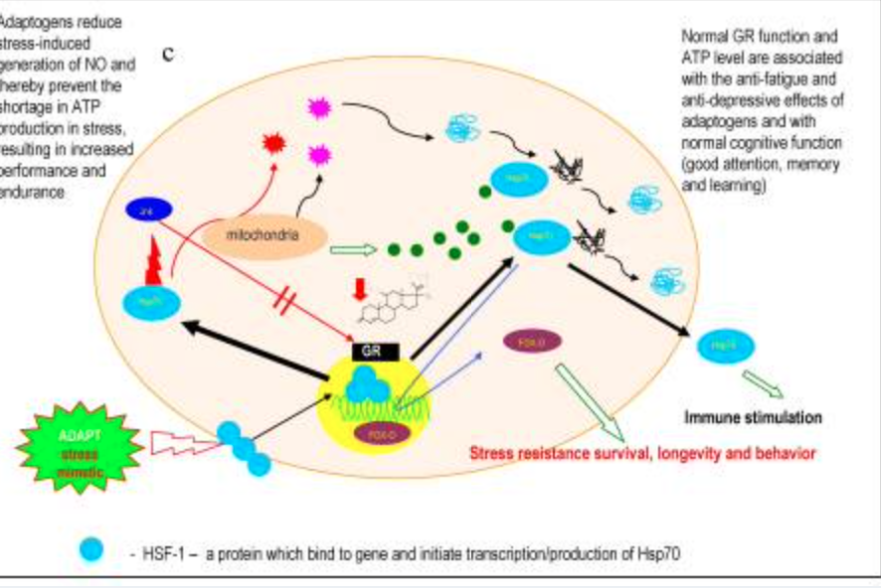
HOW DO ADAPTOGENS WORK
STIMULATE CELLUAR DEFENSES SYSTEMS BY SIGNALING PATHWAYS
GABA/SEROTONIN/FOXO/SOD RECEPTORS
WILL VARY DEPENDING ON YOUR GENETICS
ATP BIOSYTHESIS FOR ENERGY

Slide 48
ASHWAGANDHA
-Stress, anxiety, improved energy, sleep inflammation
-herb in tea
-liquid tincture
-powder
-supplement
Best Friends
reishi, tulsi, rhodiola, nut milk, ghee, honey, cinnamon, cardamon
Dose – 300 mg twice per day

Slide 49
RHODIOLA ROSEA
Stress, energy, stamina, memory
Supplement
Tincture
Powdered extract
Best Friends
Lions mane, cacoa, honey
Dose
Supplement 200 mg twice per day

Slide 50
HOLY BASIL (Tulsi)
Stress, Anxiety, Mood, Digestion
Tea
Liquid tincture
Supplement
Best Friends
Reishi,ashwagandha, black pepper, ginger, hawthorne berry
Dose
500 mg

Slide 51
Joan Hogan RD
Vegitrd@gmail.com

Slide 52
Tom Seaman
Life Coach, author and Support Person
“Every step toward your goal is just as important as the goal itself”
“Never give up- Never stop climbing toward your goal”
TomSeamanCoaching.com

Slide 53
Patrick Hogan
Restorative Movement and Life Coach
In Aligned Movement (IAM)
www.inalignedmovement.com
Feel free to contact for free initial consultation.

Slide 54
Dr Patrick Hogan
Hoganpsn@aol.com

